Slide 1
Final-OOP Project
Anime-Movie-Review
Done by Avgustine Chynarbekov Adenov Erkhan

Slide 2
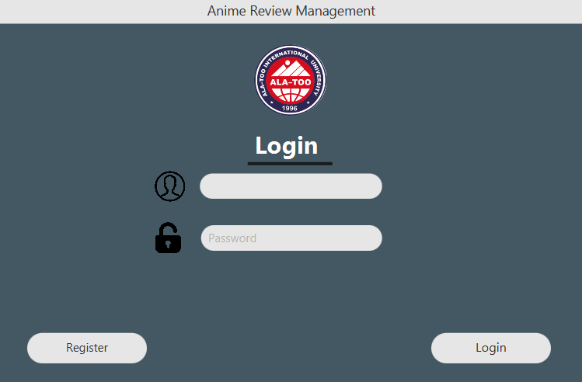
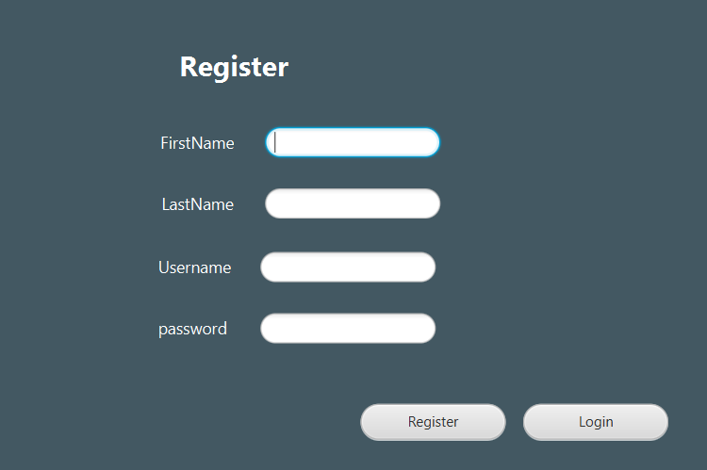
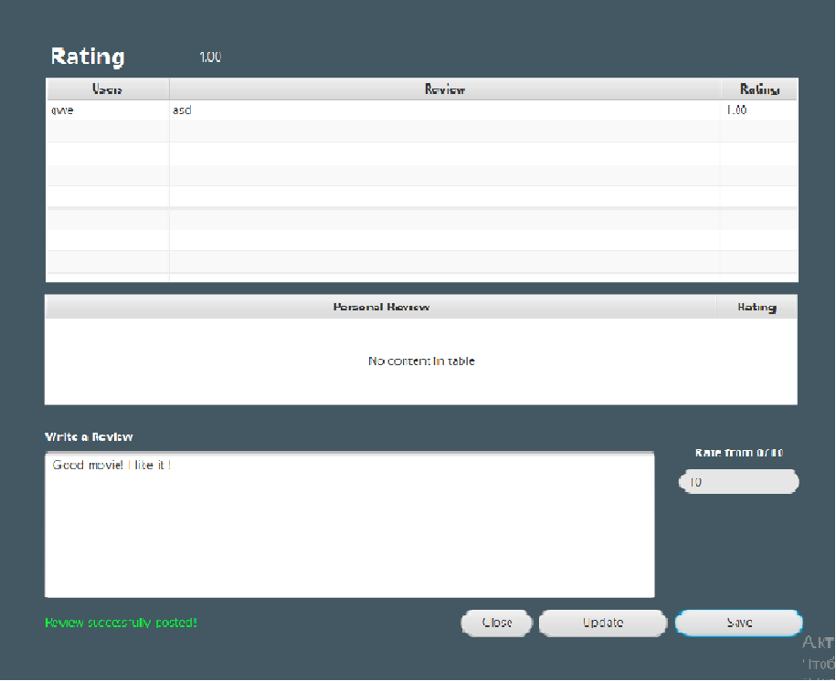
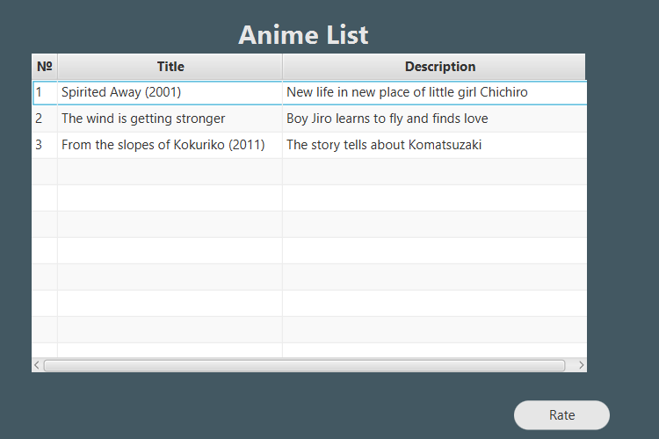
Preview

Slide 3
Introduction
This is application for managing the ratings of films. For the sake of interest to find out what ratings other people gave and how much they coincide with yours.This application is very easy to manage and understand
JavaFX MySQL Project.

Slide 4
Used Frameworks
JavaFX 17.0.2
Scene Builder
MySQL
mysql.connector.8.0.2
Workbench (8.0.2)

Slide 5
Sources
Presentation video on YouTube
Contribution guides: https://www.youtube.com/watch?v=HBBtlwGpBek
https://www.youtube.com/watch?v=e8g9eNnFpHQ

Slide 6
Contributions
Avgustine Chynarbekov https://github.com/NPaugus
Adenov Erkhan https://github.com/GalliFrey7

